Slide 1

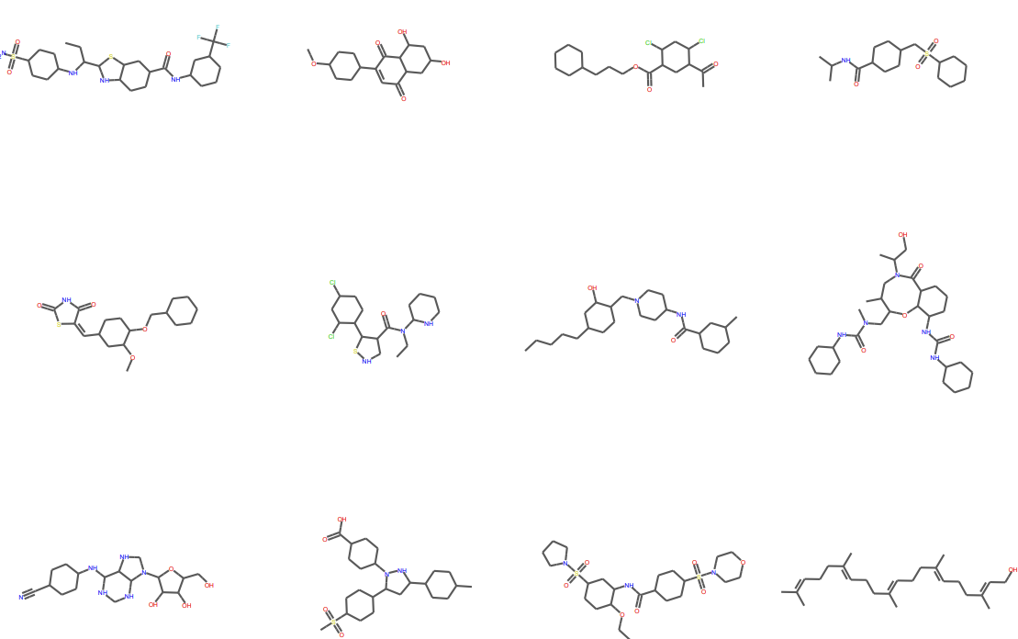
PaccMannRL: De novo generation of hit-like anticancer molecules from transcriptomic data via reinforcement learning
https://pmc.ncbi.nlm.nih.gov/articles/PMC8022157/
Harsh kumar singh
Transcriptome = the complete set of RNA transcripts (gene‐expression levels) in a cell or tissue
IC₅₀ is the concentration of a drug or compound required to inhibit a given biological process by 50%.
23b2444

Slide 2
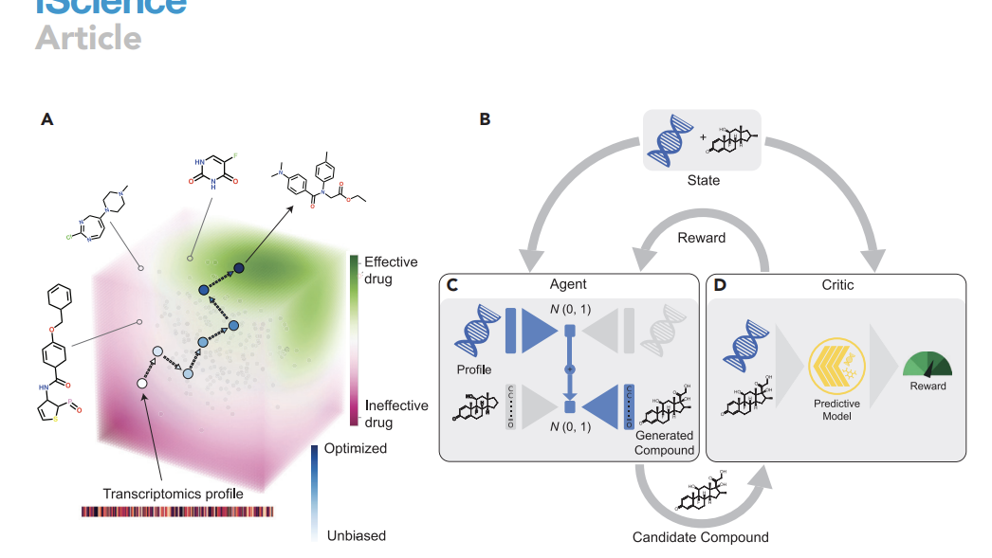

This diagram shows how reinforcement learning is used to generate cancer-specific drug candidates using a transcriptomic profile (gene expression of cancer cells) and a generative model (agent) guided by a predictive model (critic).
State-->combination of transcriptomic profile (gene expression of a specific cancer cell line) and a candidate molecule (drug)
This state is input to both the agent and the critic.
Given the gene expression (transcriptomic profile) of a cancer cell and some random noise ∼N(0,1)\sim N(0,1)∼N(0,1), it tries to generate a new molecule i.e a candidate drug optimized for that specific cell line.
Problem--->How can we steer a molecular generative model—conditioned on a tumor’s transcriptomic signature—to propose novel compounds with predicted IC₅₀ < 1 µM (i.e. pIC₅₀ > 6) against that profile, out of a chemical space of ∼10³⁰–10⁶⁰ possible drug‑like molecules?”

Slide 3


96.2% valid SMILES (vs. 95% in prior work)
99.7% unique among 10 000 samples
100% novel (none in training set)
Tanimoto similarity mostly 0.2–0.6 to ChEMBL, showing diverse novelty
(B) How Training Actually Works
Agent = Two VAEs Fused Together
Profile VAE
Trained on 10,000 bulk RNA seq from TCGA
Trained as a denoising VAE (add noise to inputs, force decoder to reconstruct) to boost robustness.Forces the model to learn robust, generalizable features of the data, rather than simply memorizing exact values.
SMILES VAE (SVAE)
~1.4 million bioactive compounds from ChEMBL
The purpose of the SVAE was to learn the syntax of SMILES and general semantics about bioactive compound

Slide 4
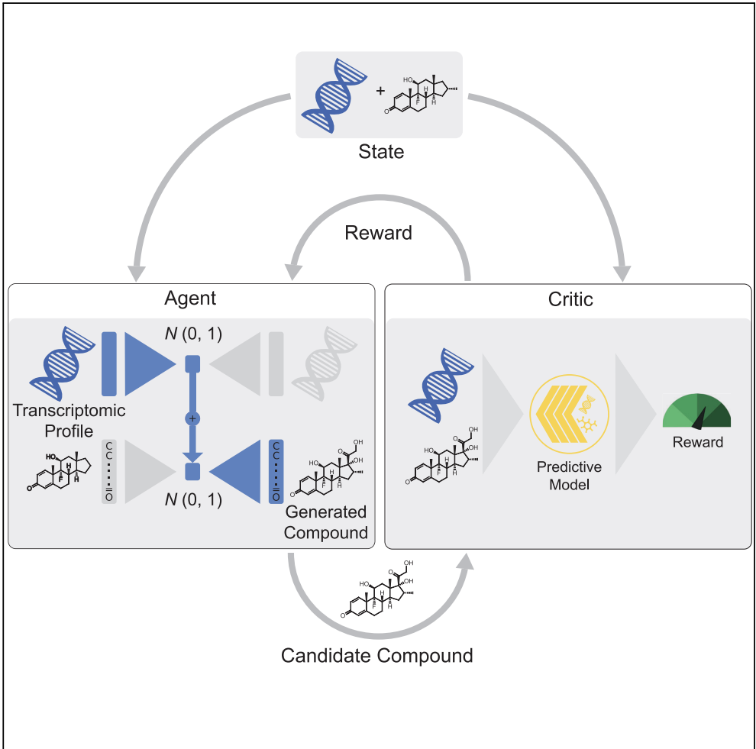
PaccMann model = Critic
It’s a deep learning model that predicts the IC₅₀ (drug sensitivity) of a compound for a given cancer cell line.
It takes the transcriptomic profile and the generated compound and evaluates how well this molecule might inhibit cancer cells.
Output: A reward score (higher is better), based on predicted efficacy (e.g., high pIC₅₀).
Reinforcement Loop (Outer Arrows)
The reward from the critic is fed back to the agent.
The agent learns to adjust how it generates molecules to maximize the reward.
Over many iterations, it gets better at generating cancer-type-specific, effective compounds.

Slide 5

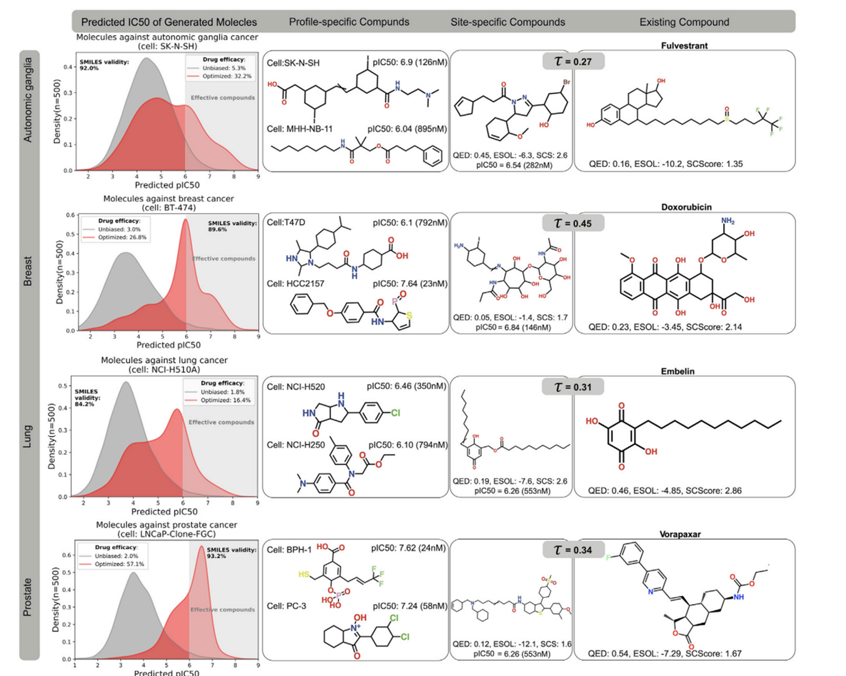
In all 4 cancer types, the red curve shifts rightward, meaning the model learned to generate more effective compounds.
Grey curve = baseline (unoptimized SVAE samples).
Red curve = optimized model (after reinforcement learning)
some terms related to diagram
QED (Quantitative Estimate of Drug-likeness) – higher is better
ESOL (estimated solubility) – more negative = less soluble
SCScore (synthetic complexity) – lower = easier to make
Tanimoto similarity (τ) – how similar the new molecule is to this drug (0–1)
profile specific
These are personalized molecules generated by the AI for a specific cell line using its transcriptomic profile
site-specific
Good across a cancer type
No cell-specific transcriptome used

Slide 6

The second column presents candidate compounds with a high predicted efficacy against a particular cell line that was not seen during training. The third column showcases generated compounds that were optimized to be effective against all cell line profiles of the given cancer type in each row. In the fourth column, we present an existing anticancer compound (approved against at least one type of cancer) that was in the top-3 neighborhood of the generated compound in the third column. The existing and generated compounds are compared in terms of Tanimoto structural similarity between RDKit fingerprints as well as three chemical scores crucial in drug design, namely druglikeness (QED, 0 worst, 1 best), synthetic complexity (SCS or SCScore, 1 best, 5 worst), and solubility (ESOL, given in M/L

Slide 7

Thank you!

